Slide 1
Improved Site Creation, Governance and Self-Service
Looking at the PnP Partner Pack and Site Scripts + Site Designs

Slide 2

About Me
Hilton Giesenow
hilton@giesenow.com
Developer, IT Pro, Architect, Consultant
Microsoft MVP Alumnus
Oleh Chadash

Slide 3
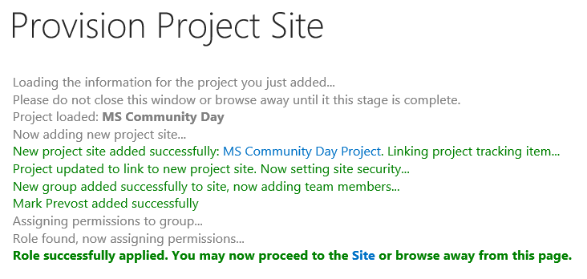
Do you have the answers to all of these?
What should our site provisioning process be?
What do we do for “Sites” versus “Subsites”?
What about O365 Groups and O365 Teams?
Do we have / enforce Governance?
Do we have / enforce standard Branding?
Do we allow Customizations?
How do we control them?
Do we need Approvals for site requests?
How do we deal with Updates?
What skills do we have? What skills do we need?
What about Classic versus Modern Sites in O365?
Notes:
Site Provisioning Process
do we have one?
What does it look like? Helpdesk ticket? Request System? Pre-creation (e.g. per division)? Self Service?

Slide 4
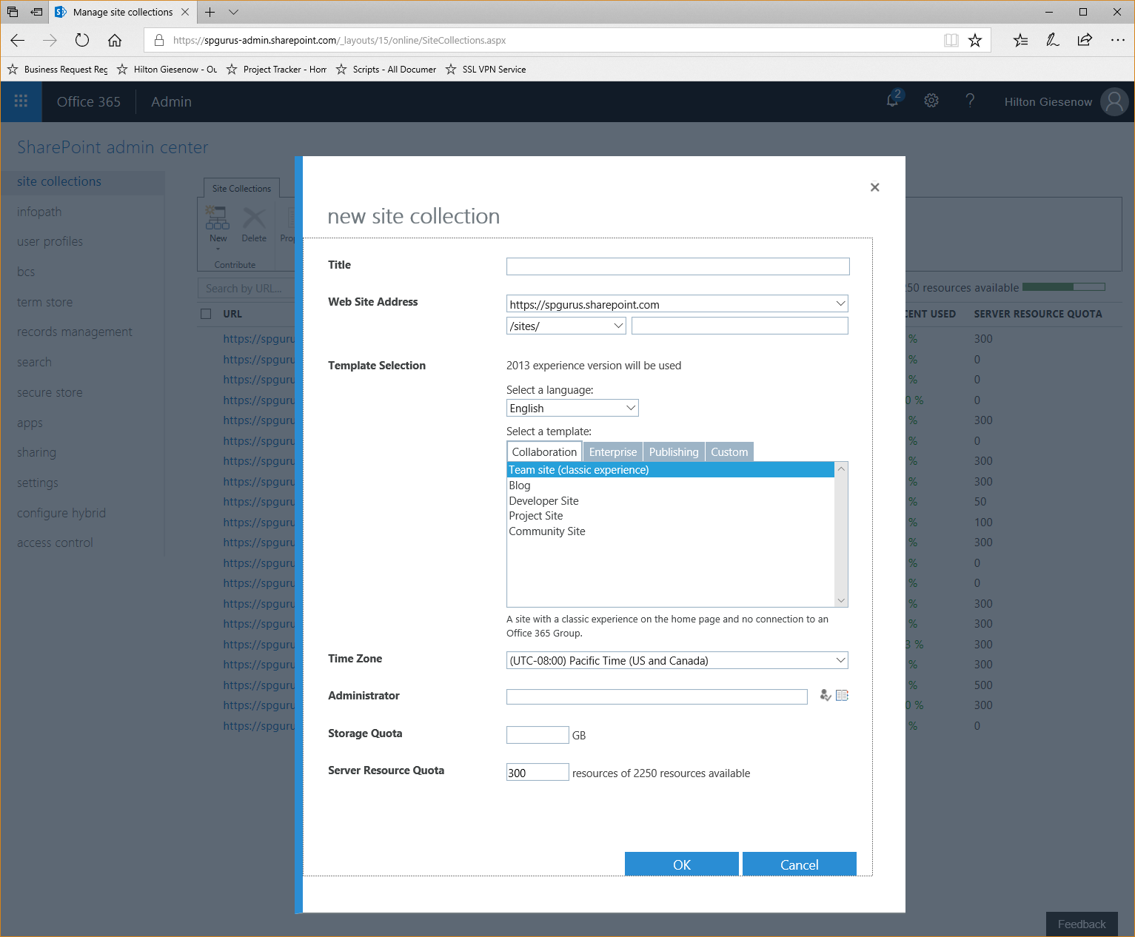
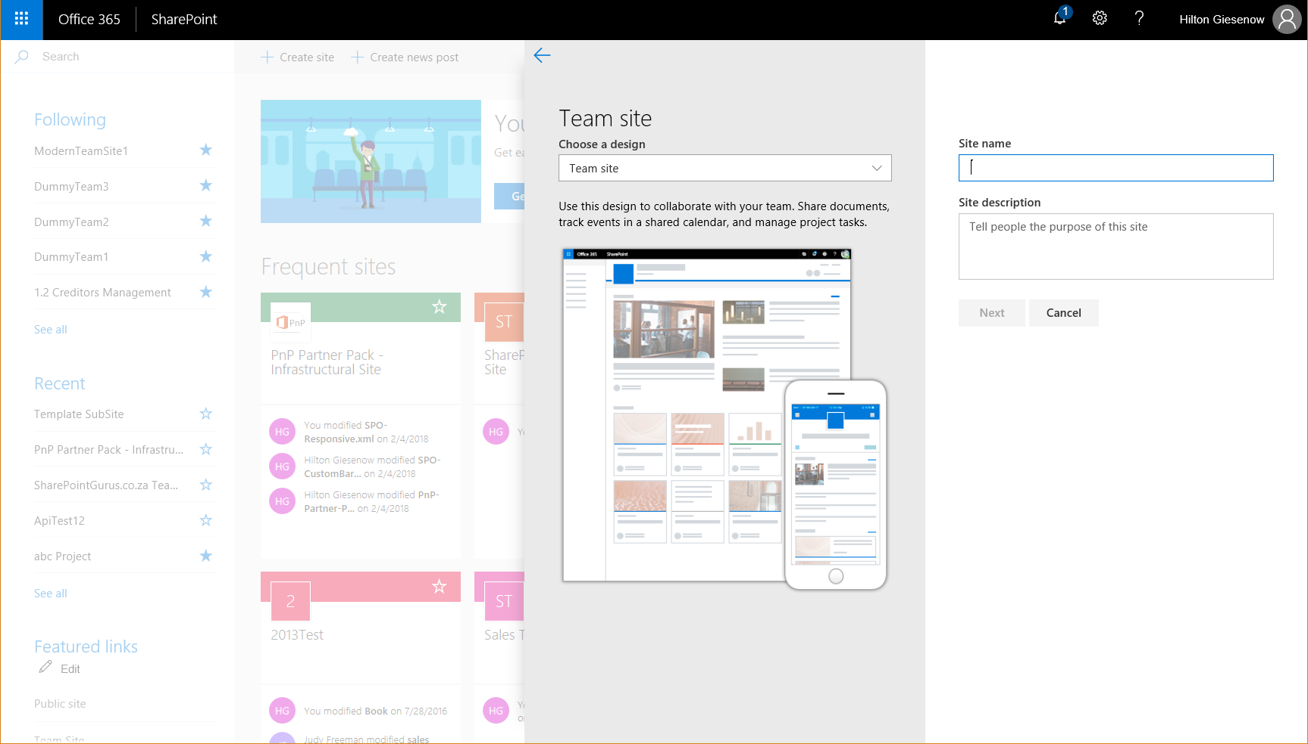
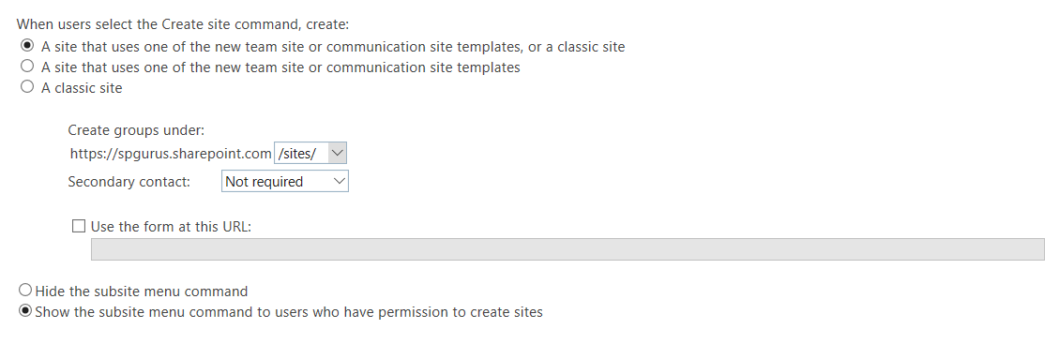
Notes:
How do we do it now?

Slide 5
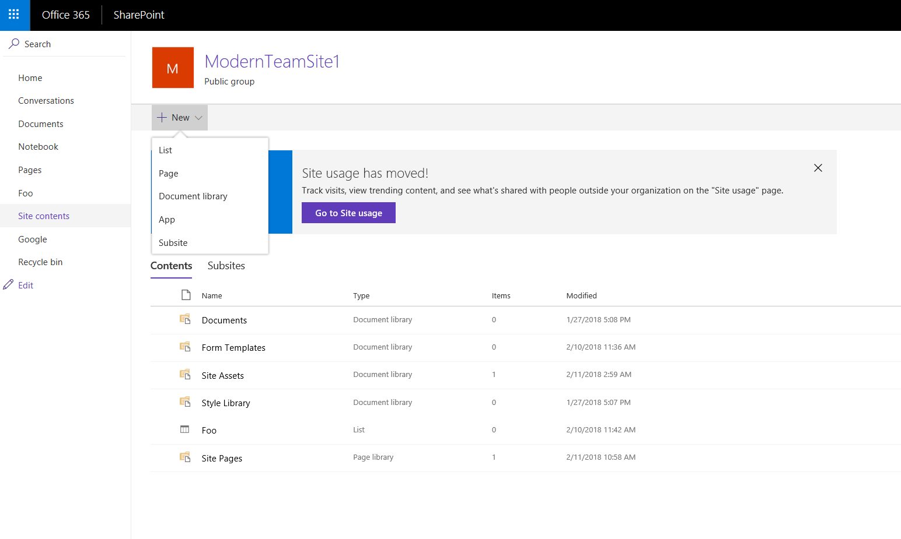
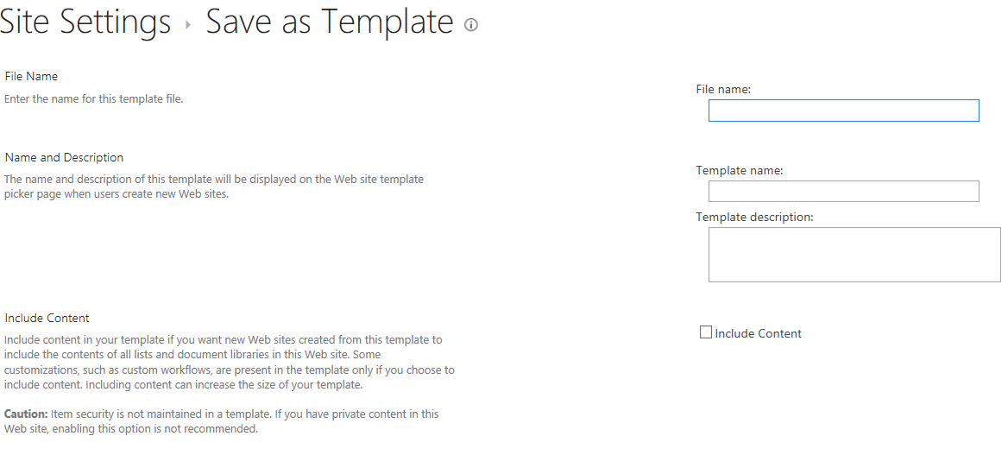
Notes:
Limited Options
Poor Experience
“All or Nothing”
Doesn’t easily go across site collections

Slide 6
Who Am I?
User
IT
Dev

Slide 7


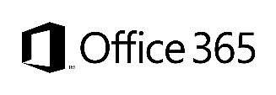
Site Provisioning Options/Comparison
Site Definition
Site Templates
Web Templates
SP Server side provisioning
Remote provisioning
No Office365
Long term impact on costs
Blocks transition to cloud
Causes significant issues with future migration and upgrade
Poor site collection creation story
Negative impact on upgrades
Causes additional maintenance costs with service updates
Not with publishing features
Poor site collection creation story
Causes maintenance costs with service updates
Provision oob sites, but modify them based on user selection and requirements
Standardization of site creation in code
No Office365
CSOM supports creation of site collections for on-premises and cloud
Standardization of site creation in code
Can be done from any external system
Options
Support in cloud
Options available
Good
Fair
Average
Good
Excellent
Cost impact (short and long term)
http://blogs.msdn.com/b/vesku/archive/2013/08/23/site-provisioning-techniques-and-remote-provisioning-in-sharepoint-2013.aspx
Notes:
Vesa
For more information on provisioning sites and associated terminology see:
SharePoint 2010 and web templates, http://blogs.msdn.com/b/vesku/archive/2010/10/14/sharepoint-2010-and-web-templates.aspx
Site provisioning techniques and remote provisioning in SharePoint 2013, http://blogs.msdn.com/b/vesku/archive/2013/08/23/site-provisioning-techniques-and-remote-provisioning-in-sharepoint-2013.aspx

Slide 8
So What Are the Alternatives?
Roll-Your-Own
PnP Partner Pack (Circa 2016 - )
Site Scripts & Site Designs (Circa 2018)

Slide 9
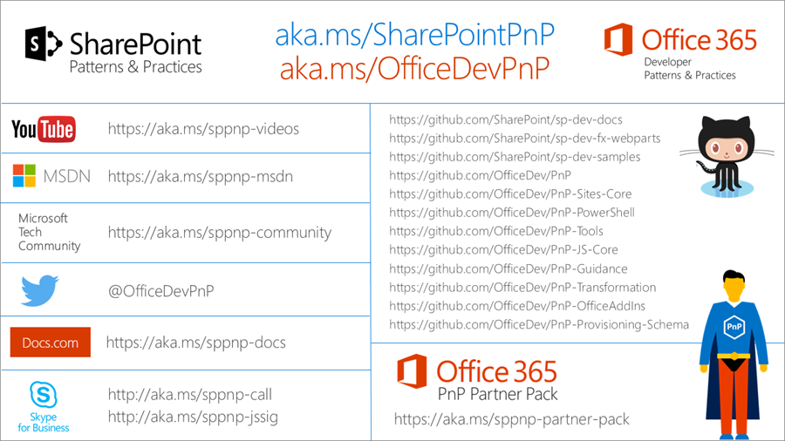
What is the “PnP Partner Pack”?
https://dev.office.com/patterns-and-practices
Notes:
PP – “Reusable starter kit for typical enterprise requirements”

Slide 10

Demo
PnP Provisioning Template
Notes:
Create Site from Template
Create Template
start scheduled job
Update Site
Show Site Creation screens

Slide 11
PnP Provisioning Engine Main Features
SP2013, SP2016 and SPO Support
Delta templates
XML, JSON formatter
Site Columns
Content Types
Lists/Libraries Instances
Features (Site or Web)
Custom Actions (Site or Web)
Files/Pages (Wiki, WebPart)
Taxonomies
Composed Look
Site Policies
Web Settings
Regional Settings
UI Languages
Resource Files
Audit Settings
Workflows (SPD only)
Search Settings
Publishing (including Page Layouts)

Slide 12
What is the “PnP Partner Pack”?
https://dev.office.com/patterns-and-practices
Notes:
PP – “Reusable starter kit for typical enterprise requirements”

Slide 13
PnP Partner Pack
(https://github.com/SharePoint/PnP-Partner-Pack)
PnP Provisioning Engine
PnP “Stuff”
Notes:
“Core” Libraries - C#
PowerShell Module on top of that

Slide 14
Demo
PnP Partner Pack
Create a new subsite using a template
Creating a new template for a subsite
Refresh a subsite
Create a new Site
Notes:
Create Site from Template
Create Template
start scheduled job
Update Site
Show Site Creation screens

Slide 15
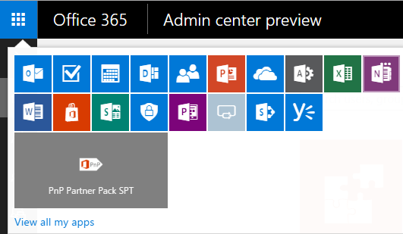
Architecture & Logic Flow
PnP Partner Pack - Manual Setup Guide
https://github.com/OfficeDev/PnP-Partner-Pack/blob/master/Documentation/Manual-Setup-Guide.md
Notes:
Im Azure Storage liegen die eigentlichen Jobs, die Einträge in der SiteColl sind nur zur Info
OfficeDevPnP.PartnerPack.ContinousJob: handles jobs using a near to real-time approach. Whenever a job is created, the engine also puts a message in an Azure Blob Storage Queue. That message will wake up the ContinousJob and make the near to real-time behavior possible.
OfficeDevPnP.PartnerPack.ScheduledJob: handles jobs based on a configurable schedule (every 5 minutes, every 10 minutes, every hour, or whatever else).

Slide 16
Demo
PnP Partner Pack
Architecture
Notes:
Create Site from Template
Create Template
start scheduled job
Update Site
Show Site Creation screens

Slide 17
Two Key Points (and a link)
Open Source
Read “What’s the Supportability Story Around This”?
“PnP Partner Pack can be considered as Starter Kit”
A Real World Customer Story: Weleda AG
https://dev.office.com/blogs/pnp-customer-story-using-pnp-partner-pack-at-weleda-ag

Slide 18

Behind Door 2: Site Designs

Slide 19
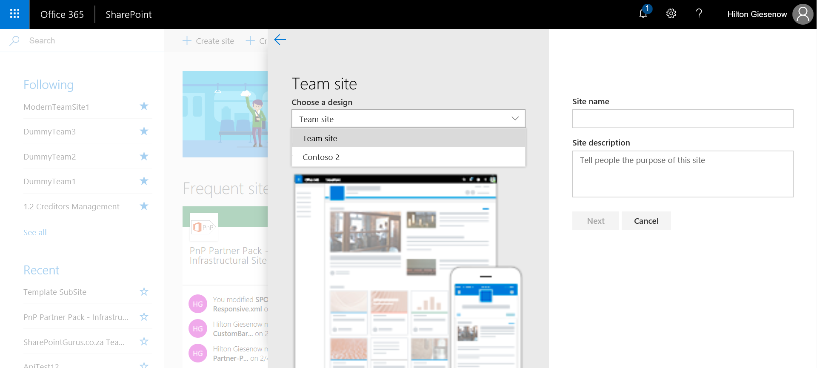

Slide 20
Demo
Site Designs

Slide 21
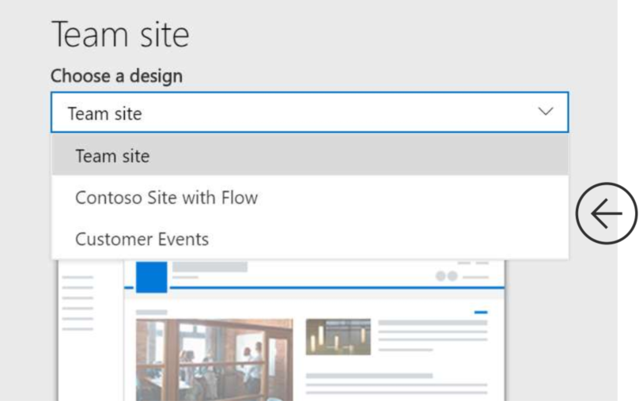
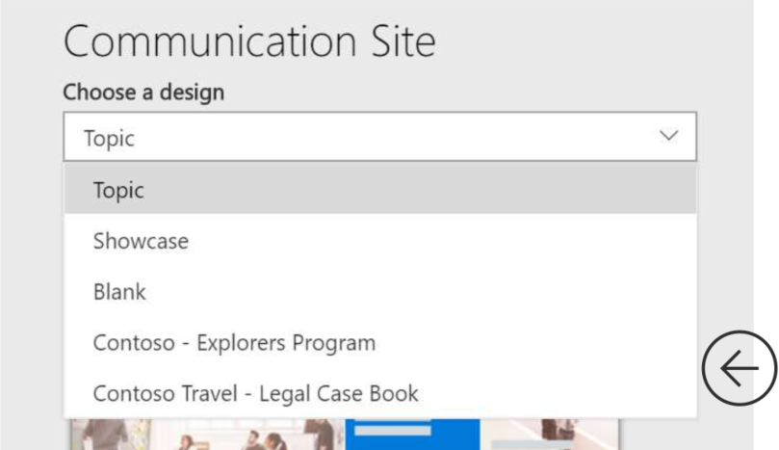
Scenarios
Add additional designs for each template type
Create a new “Default” template (override OOB)
Scope a design to a select groups of users

Slide 22
Site “Scripts” vs Site Designs
Branding Script
{
…
}
“Project” Site Design
Navigation Script
{
…
}
“Records” Site Design
List Template Script
{
…
}

Slide 23
Demo
Site Designs & Site Scripts

Slide 24
Site Script - Actions
Create a List
Certain templates
Add a navigation link
Apply a theme
Set site logo
Join a hub site
Um…
Trigger a Flow
https://docs.microsoft.com/en-us/sharepoint/dev/declarative-customization/site-design-json-schema

Slide 25
Site Script
Site Design
Flow
Azure Function
Step 1…
Step 2 – Apply PnP
Template
Step 3…
PnP Partner Pack
Site Designs
PnP Provisioning Engine

Slide 26
Which to Choose?
PnP Partner Pack
‘Free’ & OSS
Site Designs
V1.0 (almost)
Extensible (Flow) and growing
V2.0
In the Box
Fully extensible
Site Collections AND subsites
Site Collections Only
Classic sites only (OOB)
Modern sites Only
Includes Governance Mechanism
No Governance mechanism
Includes “Update” ability
No updates post implementation
“Approval” process can be added
No approval process

Slide 27
Or is it PnP PLUS Site Designs?
Total Cost = $ 0.xx
Covers Classic + Modern Sites
Covers subsites
Includes Updates and additional Governance
A good combo!
at least for now… let’s see where Site Designs go (replaced PnP?)

Slide 28
Thank You!

